Slide 1
Smart Lighting System
Group - 48

Slide 2
System bus of 8086 (Address)
A₁₆-A₁₉ S₆-S₃
A₁₆-A₁₉
LS373
BHE’/S₇
BHE’
G
OE’
ALE
AD₈-AD₁₅
LS373
A₈-A₁₅
G
OE’
AD₀-AD₇
LS373
A₀-A₇
G
OE’
MN/MX’
5V

Slide 3
2) System bus of 8086 (data + control)
RD
MEMR
WR
LS244
LOGIC
CIRCUIT
MEMW
OE’
IOR
IO/M
IOW
AD₈-AD₁₅
LS245
D₈-D₁₅
DT/R’
DIR
OE’
DEN’
AD₀-AD₇
LS245
D₀-D₇
DIR
OE’
MN/MX’
5V

Slide 4
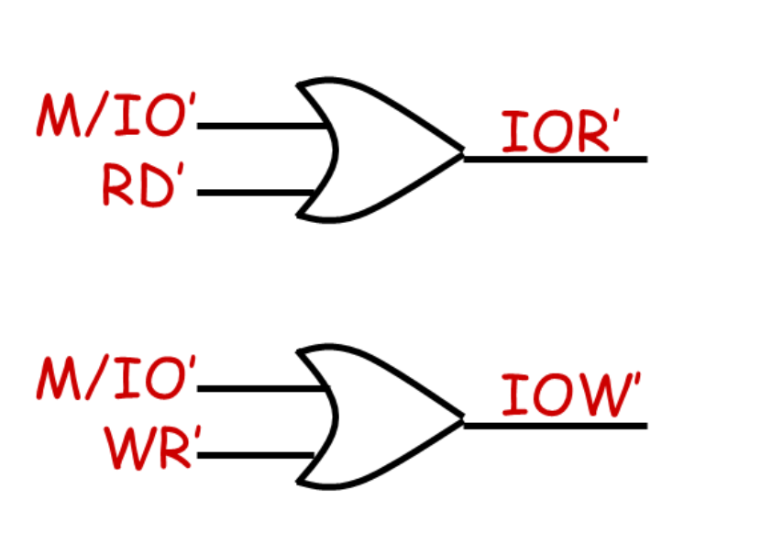
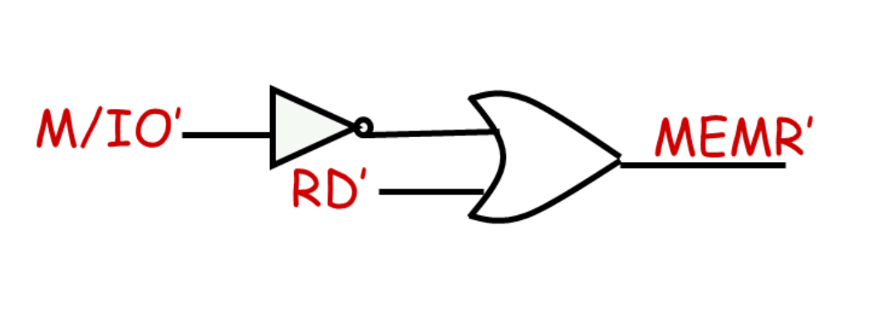
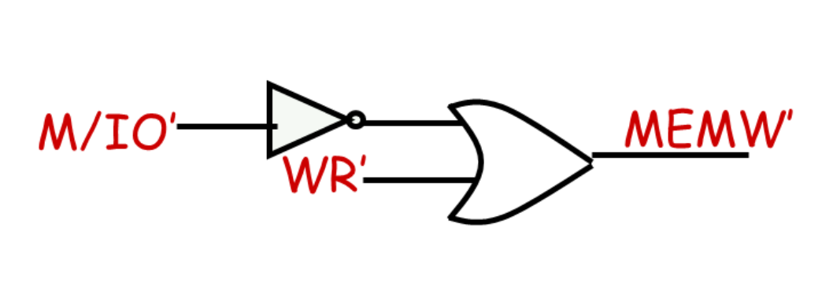
3) Logic connection for Memory and Input read/write
M / IO’ | RD’ | WR’ | Bus Cycle
1 | 0 | 1 | MEMR’
1 | 1 | 0 | MEMW’
0 | 0 | 1 | IOR’
0 | 1 | 0 | IOW’

Slide 5
4) 8086 Inputs
5V
VCC
MN/MX
Test
Not connected
HLDA
Not connected
INTR
Not connected
15 MHz
INTA
Not connected
Reset
RESET
5 V
8284
Clock
CLK
CYNC
Ready
AEN1
5V
READY
AEN2
NMI
HOLD
GND

Slide 6
5) 8255
}
D0
PA0
6:2
D1
PA1
6:1
D2
PA2
5:2
TO 8086
D3
PA3
5:1
D4
PA4
4:2
D5
PA5
4:1
Input from the sensors
A:B - Row A, Sensor B
D6
PA6
3:2
D7
PA7
3:1
}
RD
PB0
2:2
WR
PB1
2:1
A0
PB2
1:2
A1
8255
PB3
1:1
RESET
PB4
PB5
}
Input from the gate sensors
PB6
Gate sensor 2
CS
PB7
Gate sensor 1
PC0
}
1st Row LED
PC1
2nd Row LED
Output to LED on Row
PC2
3rd Row LED
PC3
4th Row LED
PC4
5th Row LED
PC5
PC6
PC7

Slide 7
6) 8255 Interface to the processor
A₁
A₀
A₂
A₁
8255 CS’
CS
IOR
RD
IOW
WR
D₀ – D₇
D₀ – D₇
RESET from 8284
RESET

Slide 8
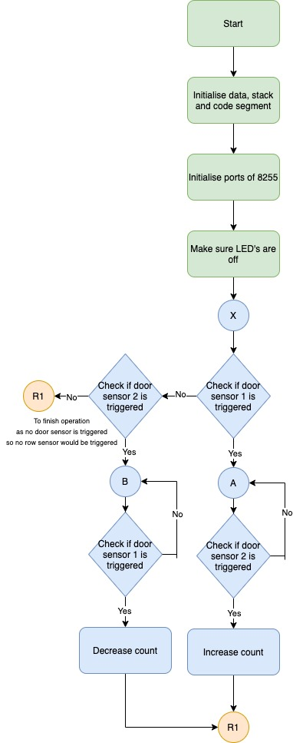
7) Flowchart
Starting and initialising
Checking the main gate sensor

Slide 9
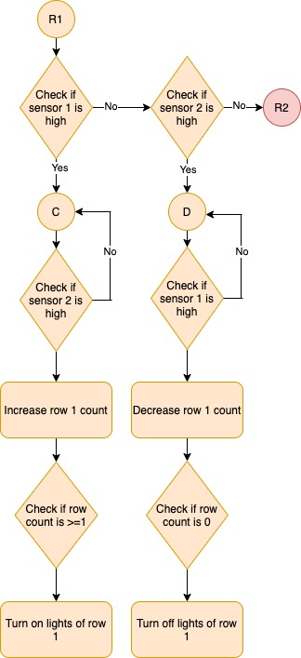
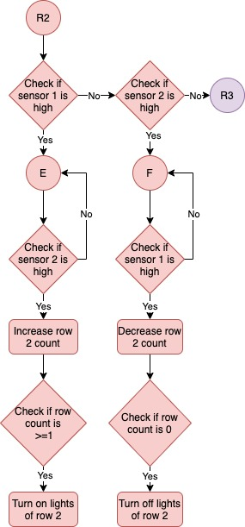
Checking the sensors of row 1
Checking the sensors of row 2
Similar flowchart to check for Row 3, Row 4, Row 5 and Row 6. After this we restart execution and check from the beginning once the door sensor is triggered again.

Slide 10
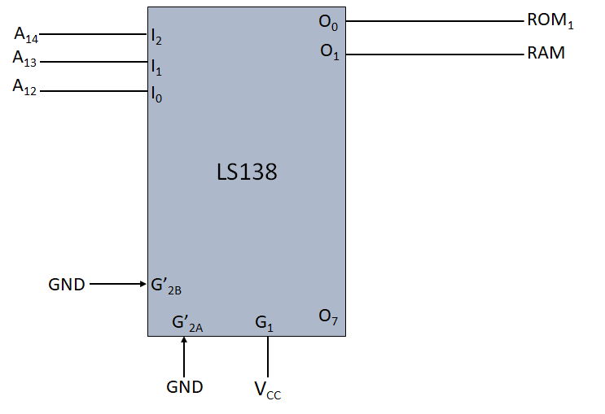
Memory Interfacing
ROM (2732): 00000h - 01FFFh
RAM (6116): 02000h - 02FFFh

Slide 11
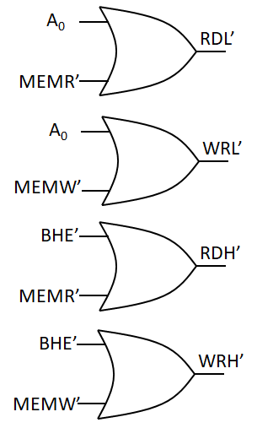
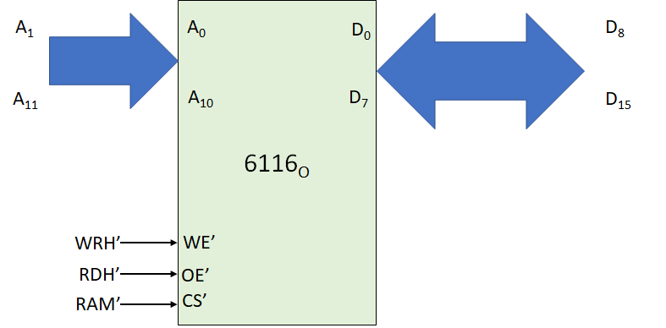
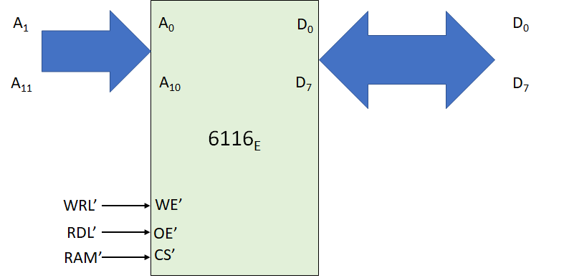
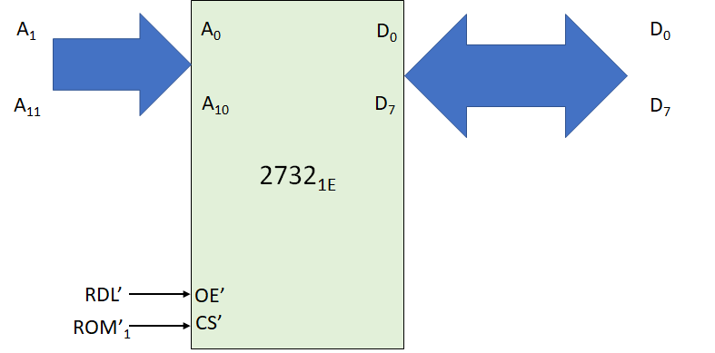
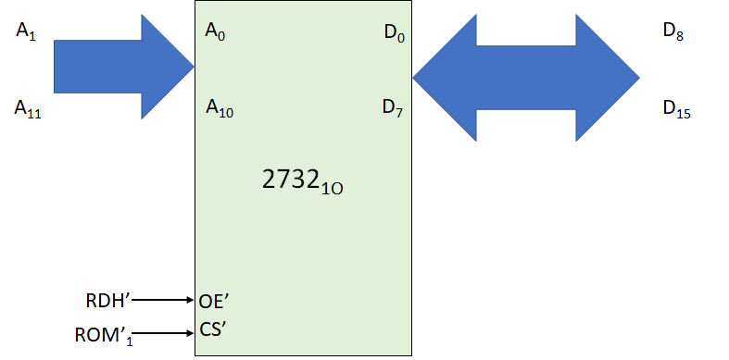
Memory Interfacing

Slide 12
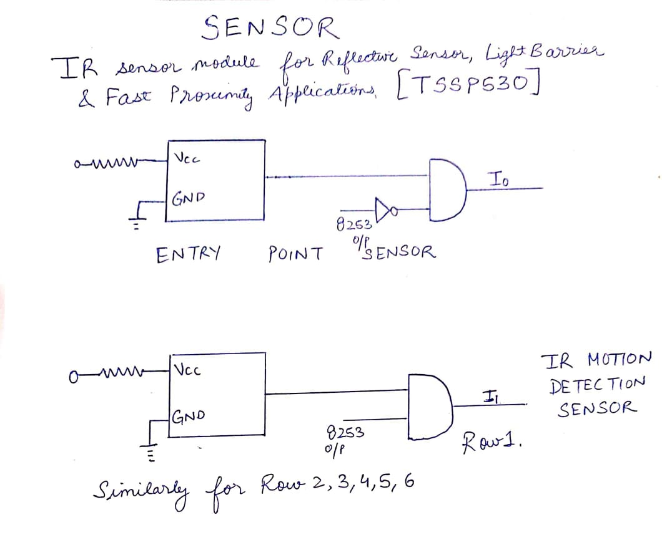
8) Sensor Diagram

